Slide 1

SMART INDIA HACKATHON SOFTWARE EDITION GRAND FINALE
1ST – 3RD AUGUST 2020

Slide 2

PROBLEM STATEMENT DETAILS
MINISTRY/ ORGANIZATION NAME: INDIAN SPACE RESEARCH ORGANIZATION (ISRO)
PROBLEM STATEMENT ID : NM378
PROBLEM STATEMENT : AI Based Crop Identification App
PROBLEM STATEMENT DESCRIPTION:
Develop a mobile application that can identify crop using only field photo of a crop. The team must target at-least 10 different crops for demonstration. The application will allow the user to take photos and automatically identify the crop. The photo and crop information along with geolocation information should be stored in an internal database which can be exported/emailed.

Slide 3

TEAM DETAILS
TEAM NAME: AGRINAUTS
TEAM LEADER: C LOKESHWAR REDDY
COLLEGE NAME : HINDUSTAN INSTITUTE OF TECHNOLOGY AND SCIENCE
TEAM MEMBERS:
K M ADITHYA KRISHNA
TAARUN SRINIVAS
R R HARSHAVARDANA
BALLA NAGA RAJESWARI
VAMSI RAJESHWAR SAI G

Slide 4

WHAT ?
An android application is developed that upon capturing an image of a crop will identify the type of crop, gives a brief description of crop and indicates the user the current location of the crop.
Other than the above mentioned information, a lot more features will also be included in the application.
The user can get to know details about various crops, their growing period, harvesting methods, diseases that affect them, pesticides to be used and lot more.
This application is believed to bridge the gap between the farmers and traders / investors using our data store and communication features.
Also, the user will be able to share the information he collected through various social media.
Concepts of machine learning is used to identify the crops and Android Studio platform is used to develop the application which will be discussed in detail during the course of our journey.

Slide 5

WHY ?
Information on crop statistics is required for planning and decision making purposes such as distribution and storage of food grains, food security, etc.
Governments and agricultural managers require these information for planning the import and export of food products.
Remote sensing data enable the determination of spatial distribution of crops at varying spatial schemes.
Despite acquiring sufficient satellite and field data, crop Identification / Classification can be very challenging and result in low accuracies.

Slide 6

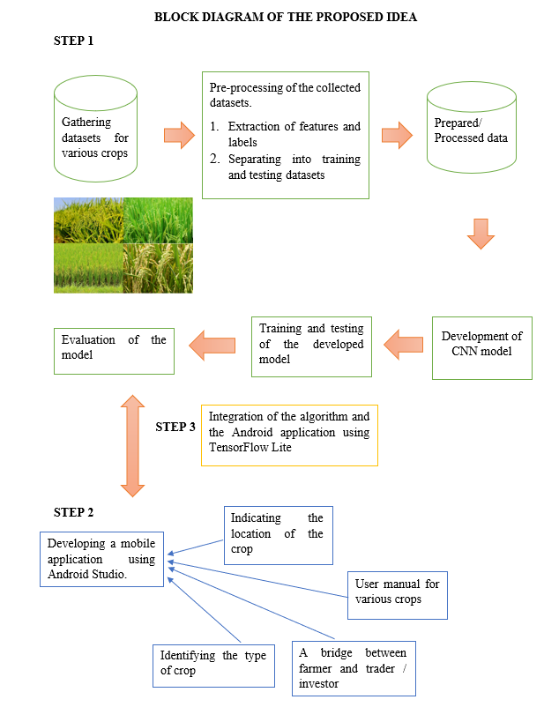
HOW ?
Convolution Neural Network (CNN), a part of deep learning is used to identify the crops.
Tensor flow is used to develop models in deep learning and Keras is used to build and train deep learning models.
Android Studio is used to develop the application and using TensorFlow Lite, the developed CNN model and the android application are integrated.
A detailed scheme of our plan is depicted in this block diagram.

Slide 7
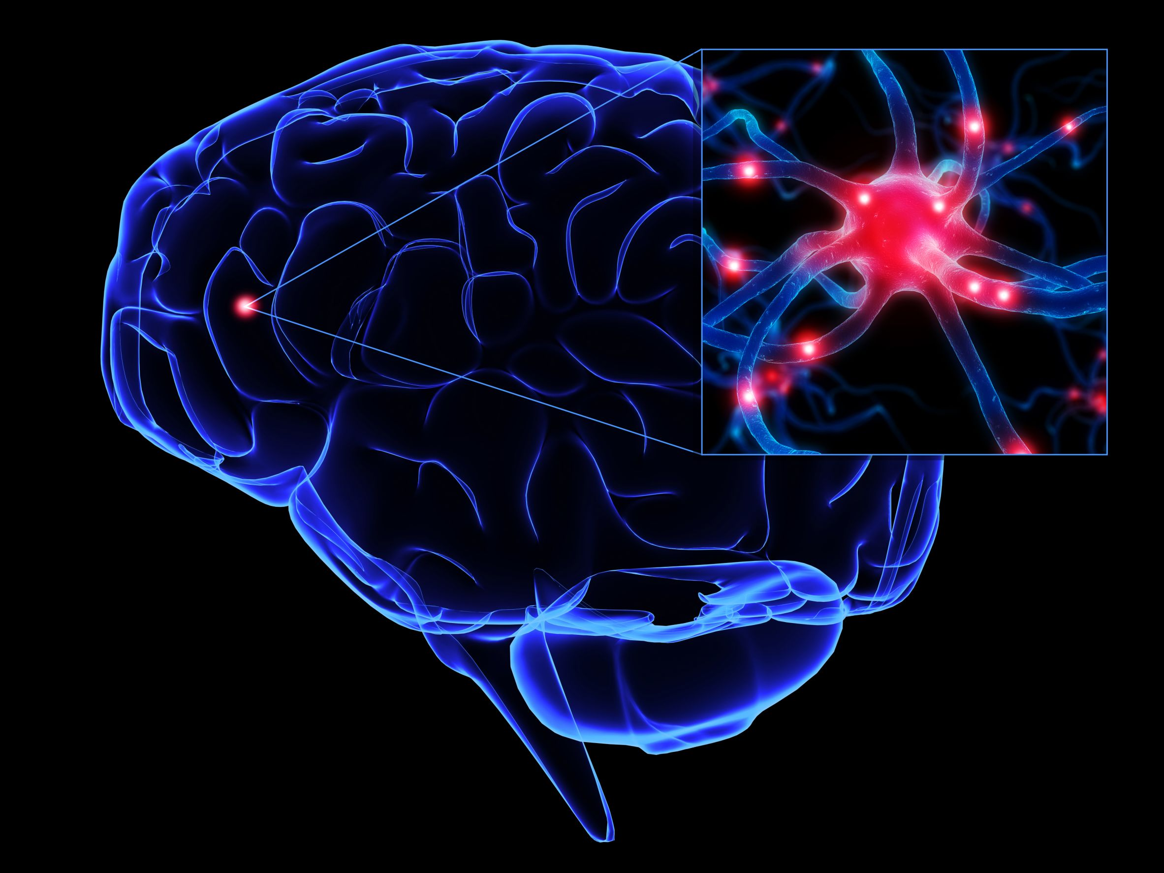
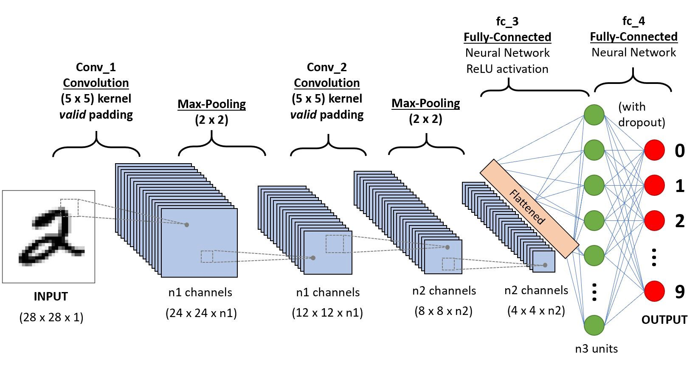
CONVOLUTIONAL NEURAL NETWROK (CNN)
A Convolutional Neural Network is a Deep Learning algorithm which can take in an input image, assign weights and biases to various aspects/objects in the image and be able to differentiate one from the other.
The architecture of a CNN is analogous to that of the connectivity pattern of Neurons in the Human Brain.
CNN is able to successfully capture the Spatial and Temporal dependencies in an image through the application of relevant filters.
In short, the role of the CNN is to reduce the images into a form which is easier to process, without losing features which are critical for getting a good prediction.

Slide 8

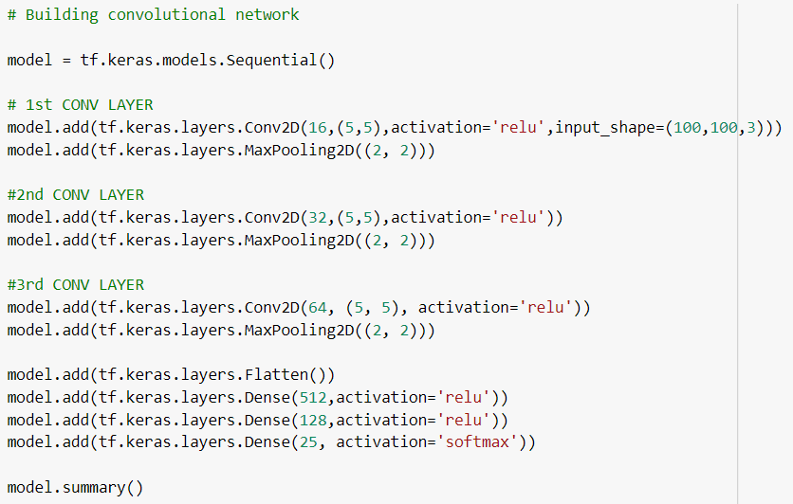
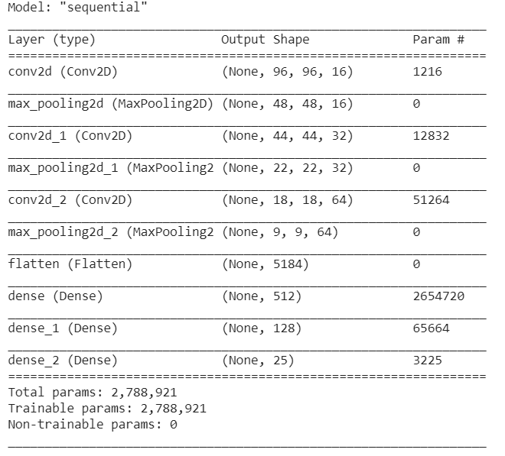
CNN MODEL DEVELOPED
The first part of a Convolutional Layer is called the Kernel layer involving in carrying out the convolution operation.
The objective of this layer is to the high-level features such as edges, colour, from the input image.
The second part of convolutional layer, Pooling layer is responsible for reducing the spatial size of the Convolved Feature.
This is to decrease the computational power required to process the data through dimensionality reduction.

Slide 9

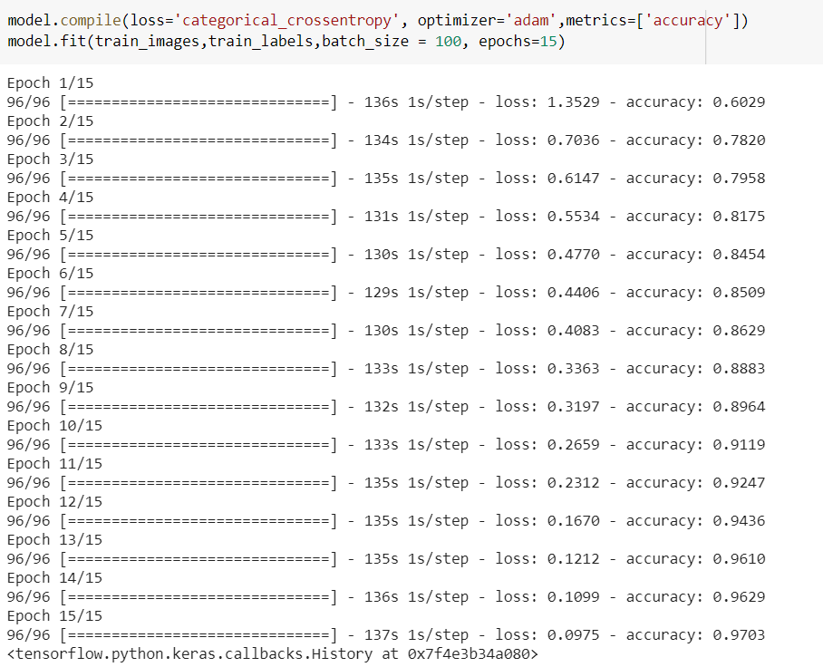
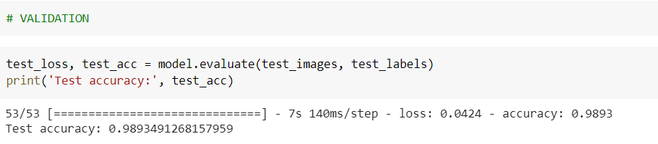
ACCURACY AND PERFORMANCE
Accuracy metrics is the measure of how accurate your model's prediction is compared to the true data.
Loss function is the sum of errors made for each example in training or validation sets. It implies how poorly or well a model behaves after each iteration of optimization.

Slide 10

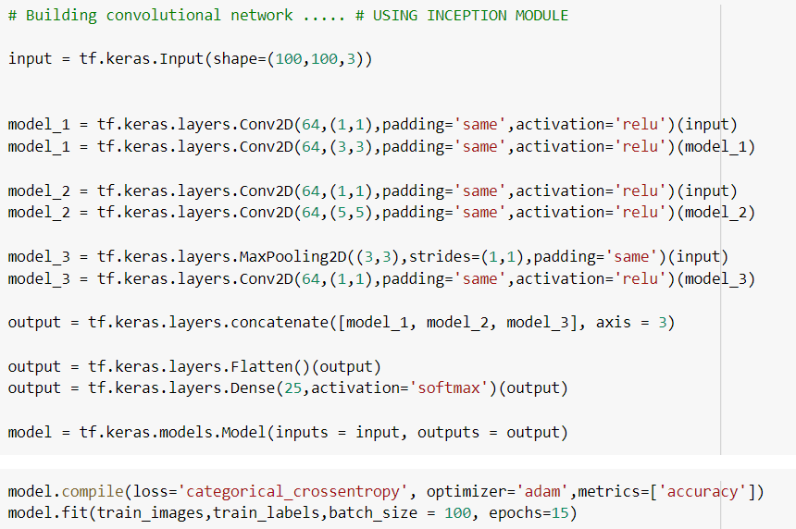
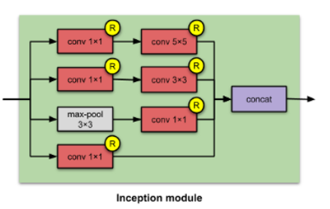
INCEPTION MODULE

Slide 11

WHAT IS SO UNIQUE ABOUT OUR APP?
Crops can be identified from any picture
All the details about any particular crop is available; such as, fertiliser, pesticides, fungicides, diseases, seasons, tips, expert suggestions and a lot more
Communication across the farmer, labour, trader and investor can be easily established in the app itself to communicate and take decisions on various matters and also to keep a tab on the progress
Diseases can also be identified from a picture and also the relevant solutions such as pesticides, fungicides, etc. or other natural solutions are also provided
A huge boon for upcoming young farmers
This app also enables the user to know the location of the crops available in the country and also share photos along with details about the crop on social media
Everything a farmer needs is right here

Slide 12

THANK YOU !!!

